Slide 1
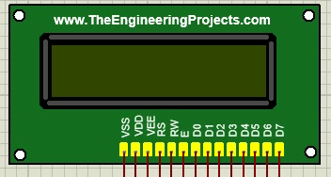
IoT based water quality monitoring system
Group 03
Sabbir Hossion 2017-1-60-112
Md Ashrafur Rahman 2017-1-60-125
Aminul Islam Bhuiyaan 2017-1-60-111

Slide 2



Motivation
Improving Health by Water Quality Indications
Business Potential for Local Market
Increase Awareness Among People of Rural Area
Improvement of the Existing Device

Slide 3

Goal
Monitoring Water Quality in Real Time
Detect Pollution or Possible Contamination
Creating data for measuring water quality in any specific geological location

Slide 4

Technology
Arduino UNO - ATmega328P
GPS
GSM
TDS Sensor (SEN0244)
pH Sensor (SEN0161)
LCD Display
solenoid valve

Slide 5
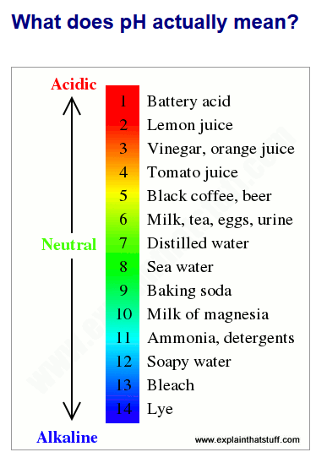
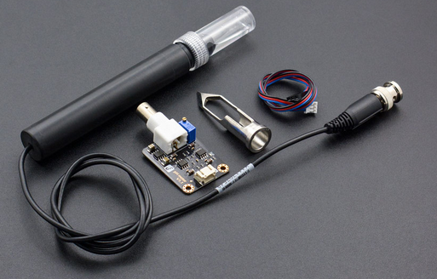
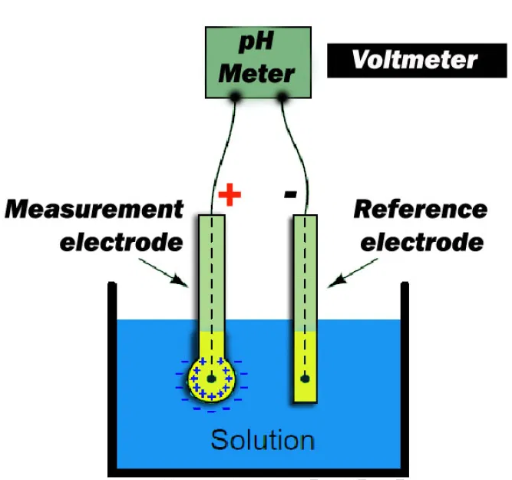
How pH measure the water quality
The potassium chloride inside the glass electrode (shown here colored orange) is a neutral solution with a pH of 7, so it contains a certain amount of hydrogen ions (H+). Suppose the unknown solution you're testing (blue) is much more acidic, so it contains a lot more hydrogen ions. What the glass electrode does is to measure the difference in pH between the orange solution and the blue solution by measuring the difference in the voltages their hydrogen ions produce. Since we know the pH of the orange solution (7), we can figure out the pH of the blue solution.

Slide 6
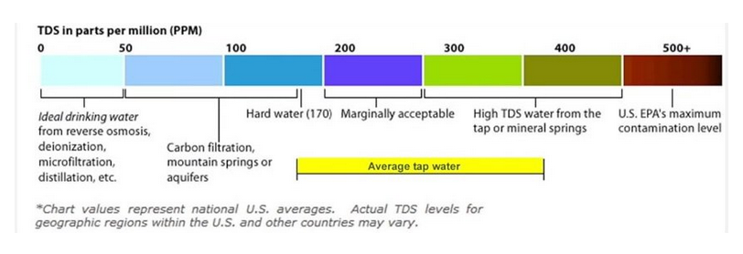
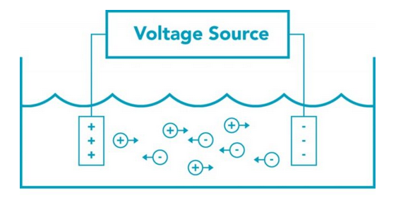
What is “TDS”?
TDS is an abbreviation for Total Dissolved Solids in a liquid, including organic and inorganic substances in a molecular, ionic, or micro-granular suspended form. TDS is generally expressed in parts per million (ppm) or as milligrams per liter (mg/L). TDS is directly related to the quality of water i.e., the lower a TDS figure, the purer the water. As an example, reverse osmosis purified water will have a TDS between 0 and 10, whereas tap water will vary between 20 and 300, depending on where you live in the world.

Slide 7
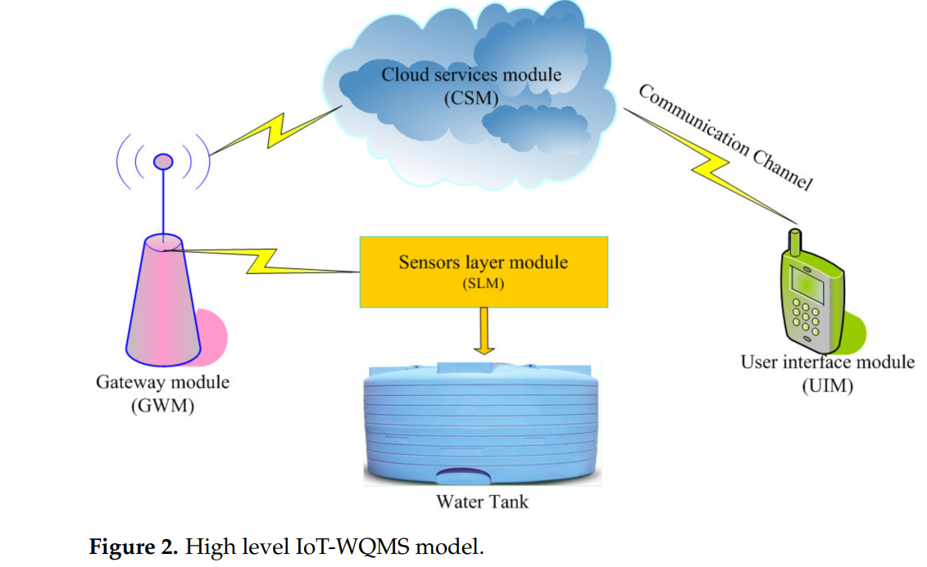

Slide 8
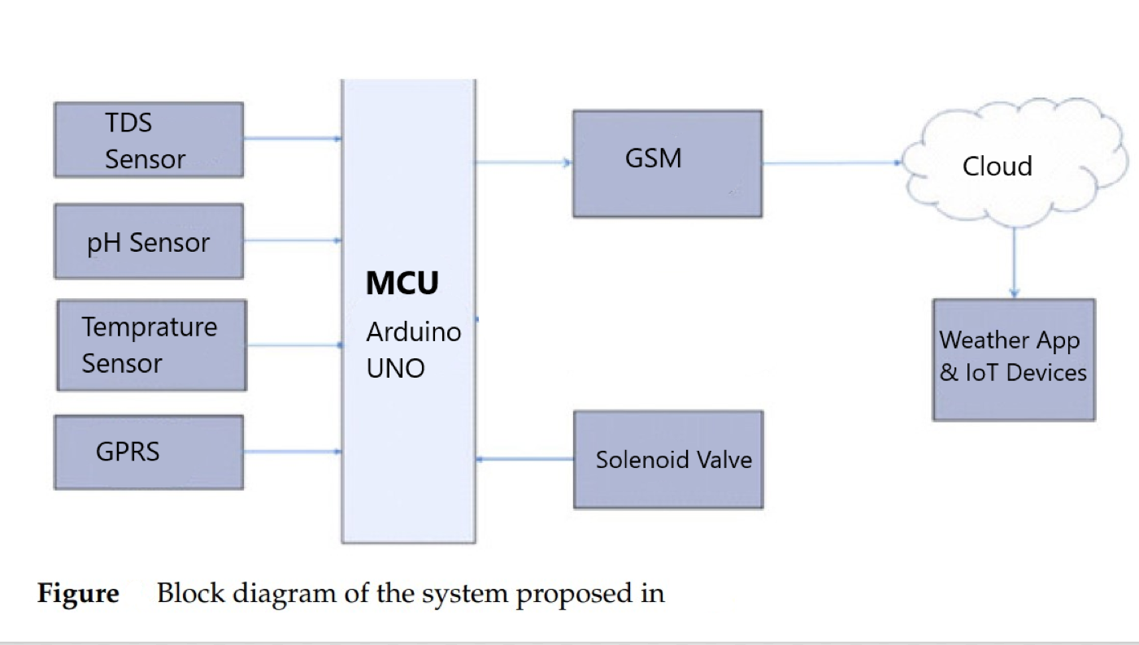
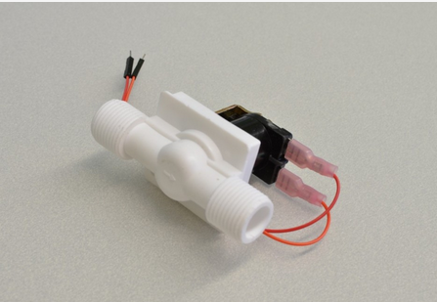

Slide 9
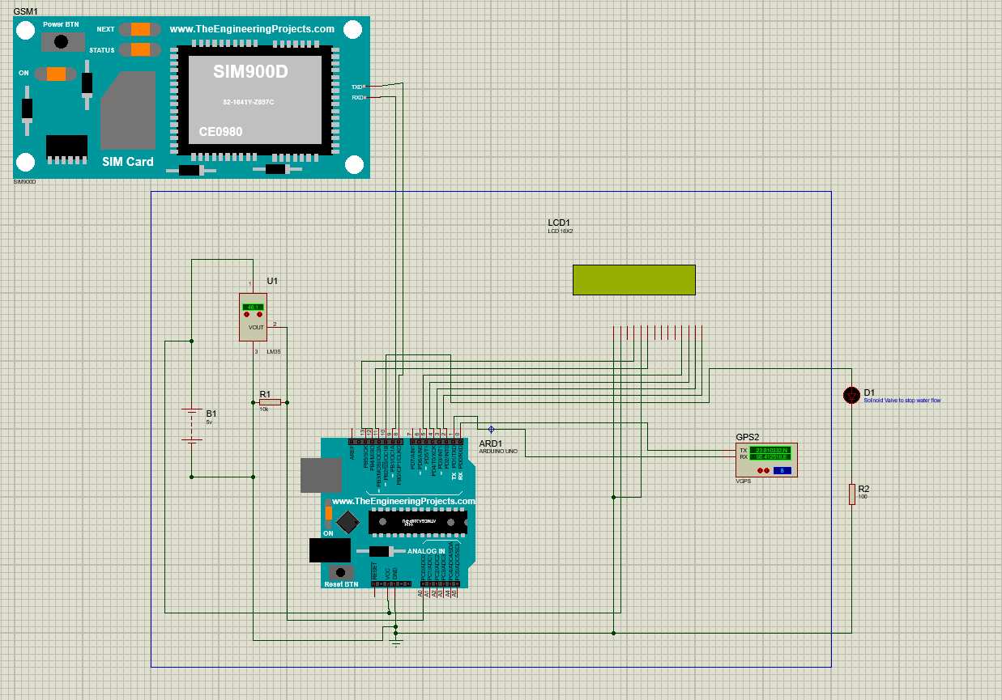

Slide 10
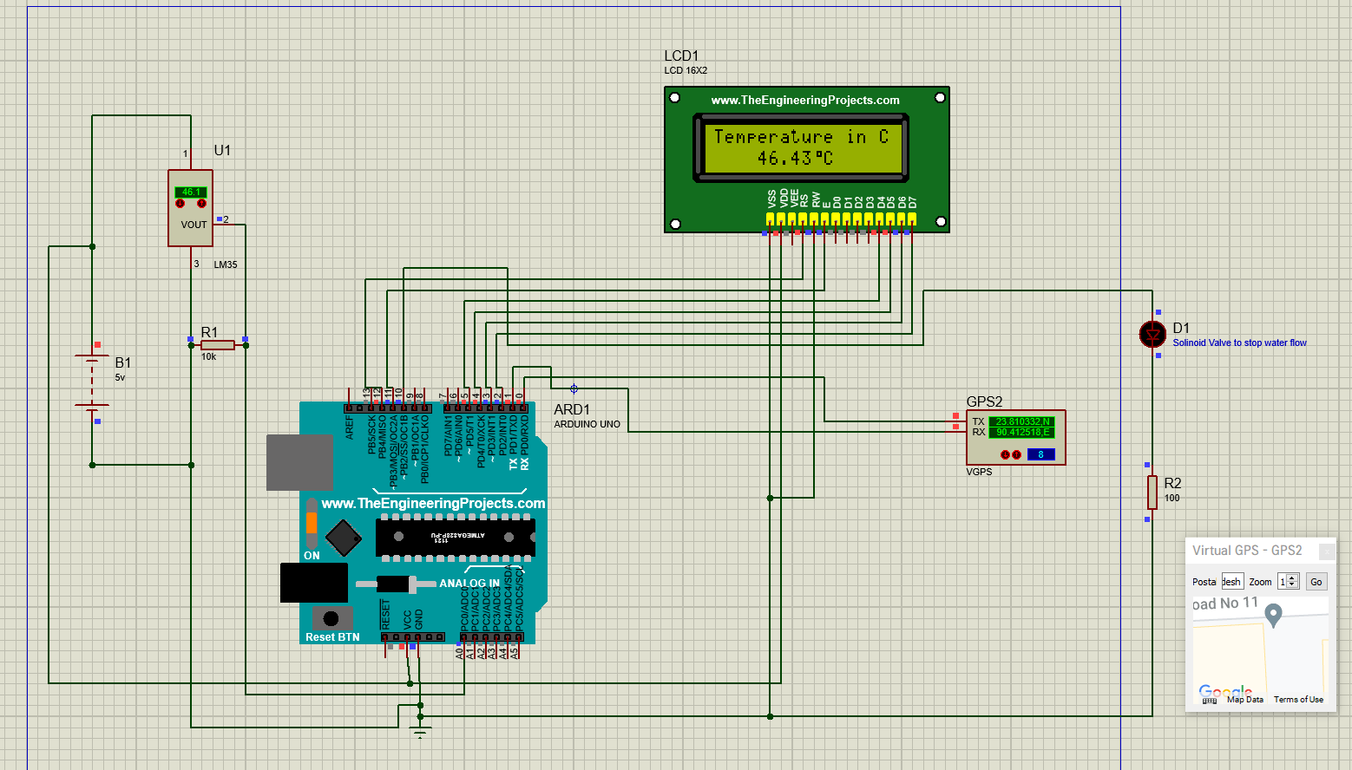

Slide 11

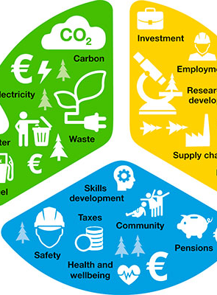
Contribution
Incorporate water quality one weather monitoring system
To control water flow when it is harmful to health
Sending data for analysis from a specific location to any monitoring system

Slide 12

Conclusion
Helps monitoring water quality in rural areas
Available for personal use
Affordable

Slide 13

Thank You

